Slide 1

Digital Security 101
August 2025
ivan@securitymatters.asia

Slide 2

Our Organization
Security Matters (SecM) is a NGO working to protect at-risk groups in East and Southeast Asia by strengthening their digital and physical security.
We achieve this by:
Promoting digital security awareness
Serving as the first point of contact for security threats
Providing first responder support and resources
Creating localized tools to address unique threats

Slide 3
Ground Rules
Communication: Please be clear and avoid using jargon.
Respect: Be respectful of the views of others, even if you disagree.
Concentration: Keep other devices closed to stay focused.
Participation: Participate fully but it's okay to say "pass" if you're uncomfortable.
Breaks: Let us know if you need to take a break.
Privacy: Don't record or share workshop content, including quotes or images of other participants.
These guidelines are intended to create a positive and respectful environment for all participants. If you have any questions or concerns, please don't hesitate to ask the organizers. Thank you.

Slide 4
Risk Assessment

Slide 5
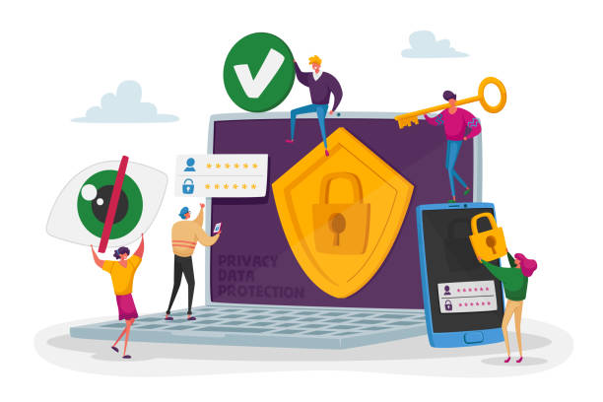
1. Risk Assessment
A tool to help identify potential risks or threats to the security of your digital assets (e.g., data), and evaluating the likelihood and potential impact of those risks.
Keeps you safe while using your computer or phone.

Slide 6
1. Risk Assessment
First step: Threat Modeling
A way of thinking about the sorts of protection that you want.
Helps you to prioritize on what you should concentrate on.
Questions to ask yourself:
What do you want to protect? Where is it kept? Who has access to it?
Who do you want to protect it from?
How bad are the consequences if you fail?
How likely are these consequences?
How much trouble are you willing to go through to try to prevent the consequences?

Slide 7

Activity
Take 8 minutes to understand the questions and try to write down your threats.
Threat
Modeling

Slide 8
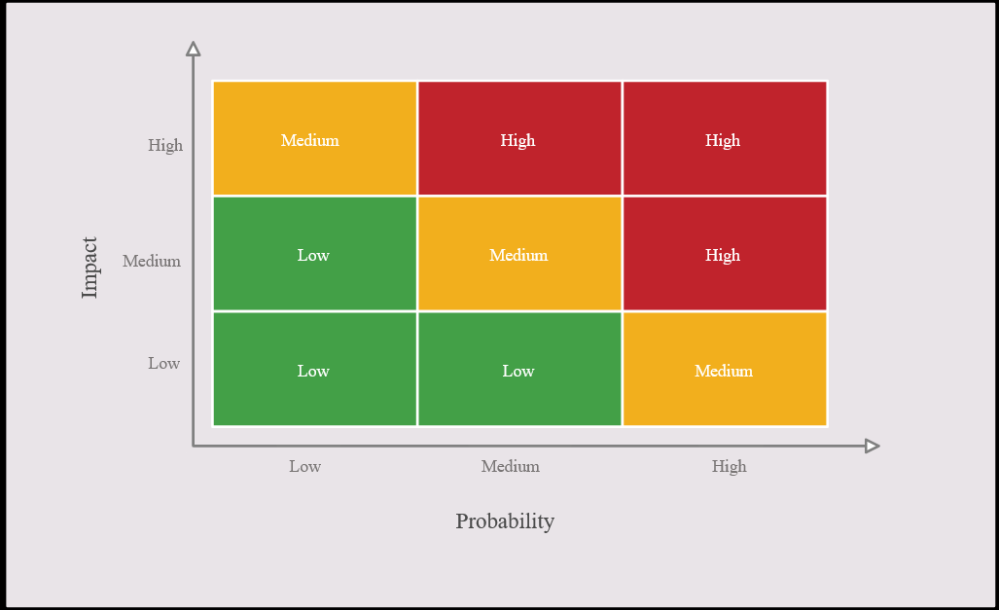
1. Risk Assessment
Second step: The Risk Impact vs Probability Matrix
Risk Impact vs Probability Matrix helps prioritize risks.
The Impact axis shows us how bad a risk would be if it happened.
The Probability axis shows us how likely it is that the risk will happen.
By identifying and addressing these high-priority risks first, we can more effectively allocate our resources and mitigate the most significant threats to our digital assets.

Slide 9
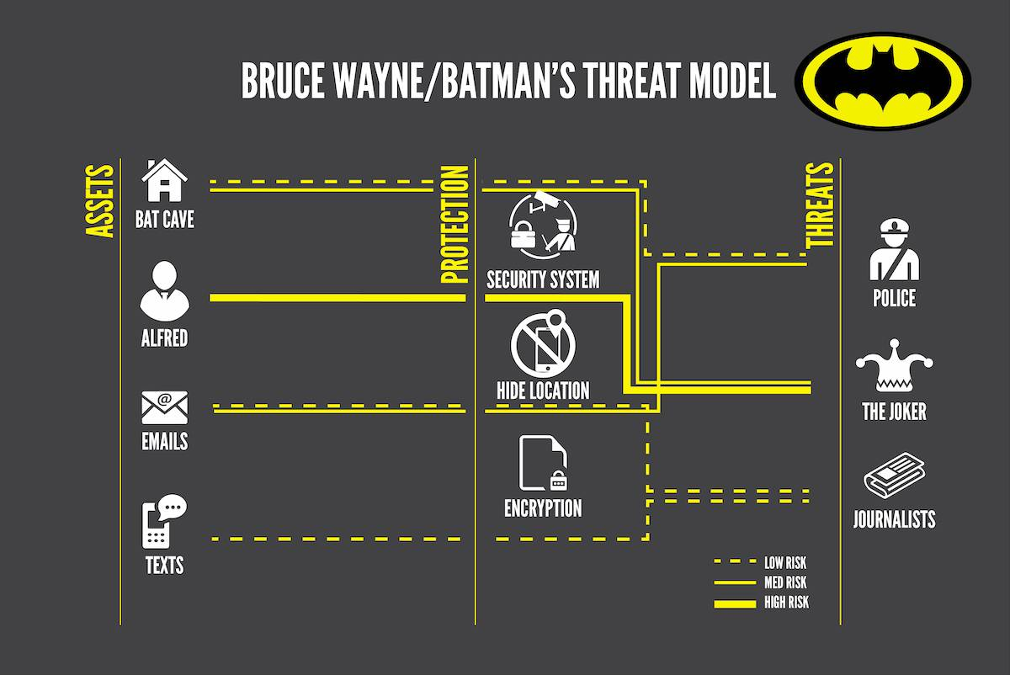
1. Risk Assessment
Example: Batman’s Threat Model

Slide 10
Digital Hygiene and Account Security

Slide 11
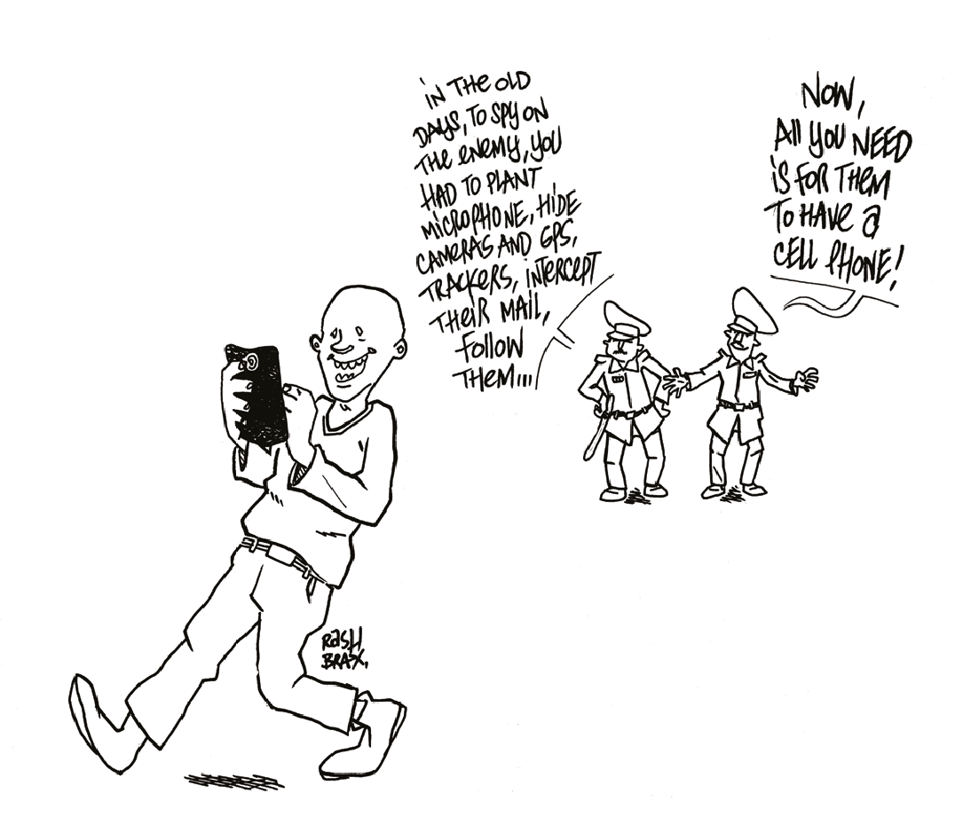
2. Digital Hygiene and Account Security
Digital hygiene refers to the practices and habits that individuals and organizations adopt to maintain their digital security and privacy.
Why is it important?
Protects sensitive information from unauthorized access or theft.
Reduces the risk of cyber attacks and data breaches.
Helps maintain trust and credibility with clients/stakeholders.

Slide 12
Digital Hygiene Checklist
Update your operating system and software regularly
Install reputable antivirus and enable firewall
Create strong & unique passwords
Regularly backup files and devices and keep hard drive clean
Download apps only from the official store
Be cautious of public Wi-Fi and public USB ports
Choose your browser carefully
Use two-factor authentication (2FA)
Protect your connection to the internet by using a VPN
Encrypt your emails and messages
Encrypt your devices and files
Be aware of phishing attacks

Slide 13
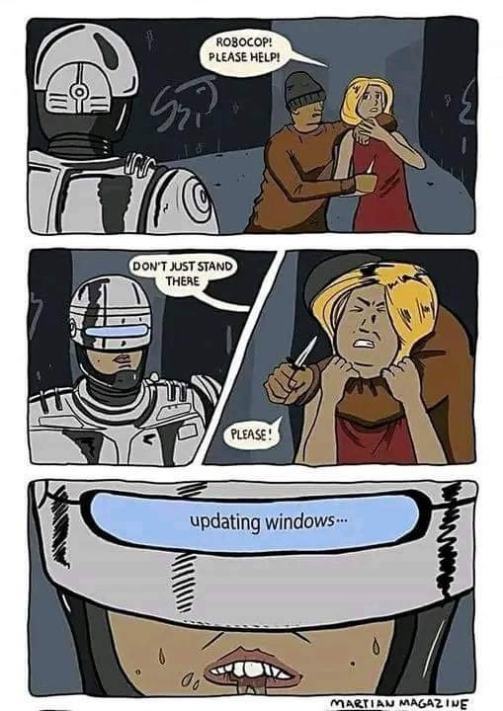
2. Digital Hygiene and Account Security
Update your operating system and software regularly
Regular updates improve security by fixing vulnerabilities and bugs.
Set your device to update automatically to ensure you're always protected.
Regular updates also improve performance and add new features.

Slide 14
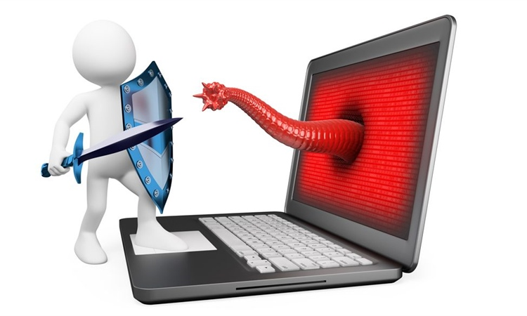
2. Digital Hygiene and Account Security
Install reputable antivirus and enable firewall
Antivirus software helps protect your device from malware such as viruses, spyware, and other types of harmful software.
E.g.: Microsoft Windows Defender on Windows and Malwarebytes on Mac
A firewall is a security tool that monitors incoming and outgoing network traffic and blocks any unauthorized access attempts.
Windows users: Check your computer vitals at the “Security” section in “Security and Maintenance.”

Slide 15

2. Digital Hygiene and Account Security
Create strong & unique passwords
At least 25 characters, contain upper and lower case letters, numbers, and special characters.
Consider using a memorable but difficult to guess passphrase.
Change your passwords often, e.g. every 6 months.
Do not allow your browser to "remember" your username and password.
Don't reuse passwords across multiple accounts.
Use a password manager, e.g. KeePassXC to help generate and store your passwords.
Check your password strength here.
Check if your personal data has been compromised by data breaches here.

Slide 16
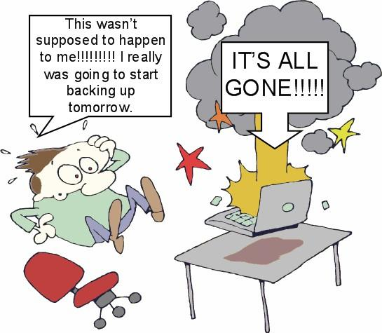
2. Digital Hygiene and Account Security
Regularly backup files and devices and keep hard drive clean
Data loss can occur due to various reasons: hardware failure, human error, cyberattacks, etc.
Backup can save your important files, prevent data loss and help recover from a cyberattack.
Backup important files regularly on a secure location, e.g. external hard drive.
If using cloud storage is unavoidable, try ProtonDrive.
Regularly test your backup device.
Regularly scan for malware and remove any threats.

Slide 17
Mobile Security

Slide 18
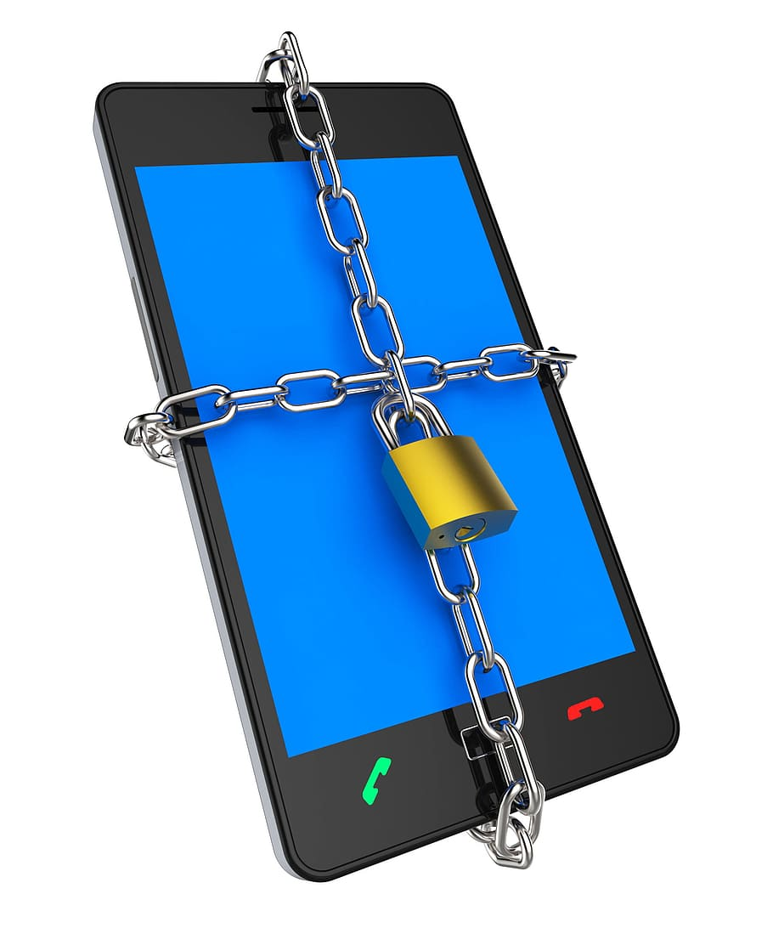
3. Mobile Security
Mobile security refers to the protection of mobile devices such as smartphones and tablets from hacking and other dangers that could steal data or harm the device.
Why is it important?
Mobile devices store a large amount of personal and sensitive information and are frequently used to access financial services, making them prime targets for cybercriminals.

Slide 19
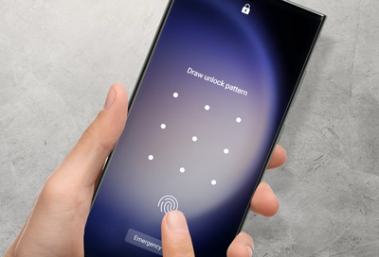
3. Mobile Security
Screen Lock
A security feature that prevents unauthorized access to your cellphone.
It can be set up with a pattern, fingerprint, PIN, password, or facial recognition.
It's important to choose a strong screen lock and avoid using easily guessable patterns or PINs.

Slide 20

3. Mobile Security
Download apps only from the official store
Be careful when downloading apps as they can contain malware that can harm your device or steal your information.
Only download apps from the official app store, i.e. Google Play or the Apple App Store.
Review the app's permissions before downloading and installing it.

Slide 21
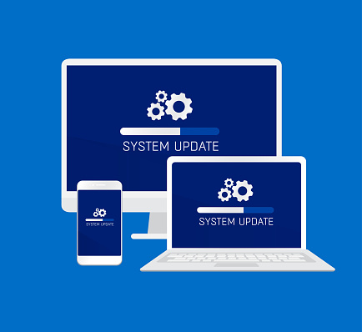
3. Mobile Security
Update your operating system and apps regularly
Why is it important?
Security updates address security vulnerabilities that could be exploited by cybercriminals.
Improved performance.
New features.

Slide 22
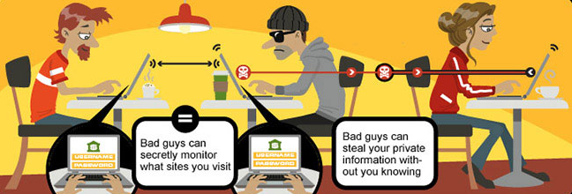
3. Mobile Security
Be cautious of public Wi-Fi and public USB ports
Always use a virtual private network (VPN) when connecting to public Wi-Fi.
Avoid logging in to any accounts that contain sensitive information like banking or email without a VPN.
Avoid using USB ports in public places, as they may be unsafe and can potentially install malware on your device.

Slide 23
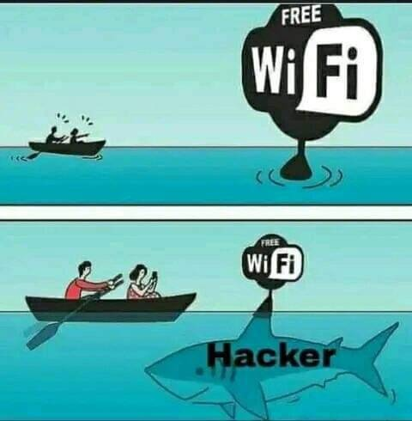
3. Mobile Security

Slide 24
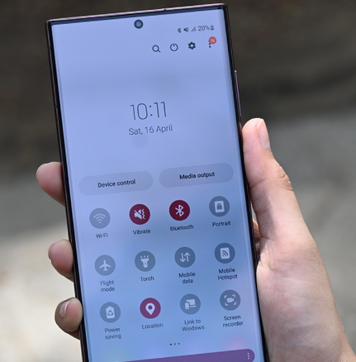
3. Mobile Security
Location Access
Giving location access to all apps can be dangerous as it can reveal your whereabouts to people you don't want to share it with.
Bluetooth
Allowing all apps to access Bluetooth can be risky as it can enable unauthorized devices to connect to your phone and access your data.
Same applies to Apple’s AirDrop.
Limiting location and Bluetooth access can help protect your privacy and prevent unauthorized access to your data.

Slide 25
Online Safety

Slide 26
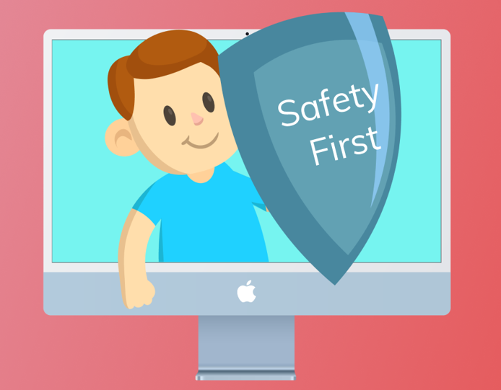
4. Online Safety
Online safety involves taking measures to protect ourselves while using the internet.
Why is it important?
When sharing things online, there's a risk of exposing personal information or sharing it with the wrong people.
Online safety is important for protecting oneself and one's personal information while using the internet.

Slide 27

4. Online Safety
Choose your browser carefully
Choosing a secure browser is an important step in staying safe online.
E.g.: Mozilla Firefox, Tor Browser.
Use Google Chrome for Google services or services not supported by Firefox.
Use extensions (plugins) that help protect your privacy.

Slide 28
4. Online Safety
Browser settings
Firefox
Firefox should be used as the default browser.
Firefox will need to have the ‘HTTPS-Only Mode’ turned on; Privacy Badger (which identifies trackers); and uBlock Origin (ad blocker) add-ons installed and enabled at all times.
Firefox will be configured to ‘Always use private browsing mode’.
Google Chrome
Google Chrome should be used only when using Google services or services that are not supported by Firefox.
Google Chrome needs to have the ‘Always use secure connections’ turned on, uBlock, and Privacy Badger add-ons installed and enabled at all times.
Google Chrome will be configured to ‘Clear cookies and site data when you close all windows’.

Slide 29
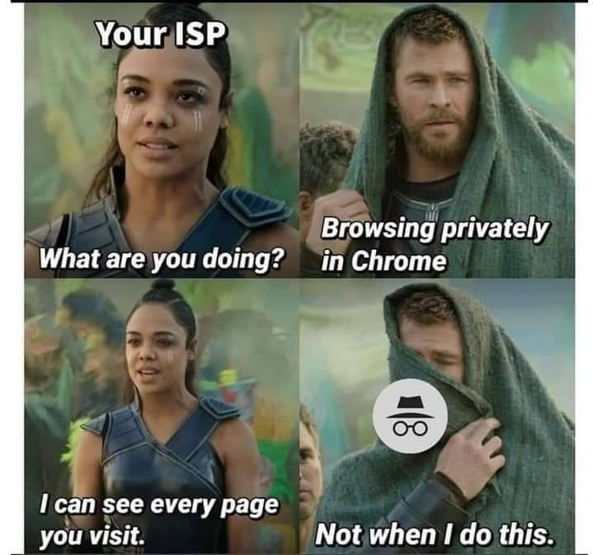
4. Online Safety
Incognito mode
A private browsing mode that can be used to browse the web without saving history or cookies.
No:
Incognito mode does not provide complete anonymity online.
Internet service providers, employer, and visited websites can still see your activity.
Yes:
Incognito mode keeps your browsing private from others using the same device.

Slide 30
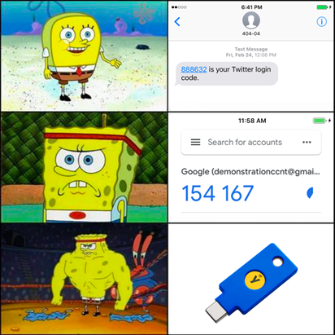
4. Online Safety
Use two-factor authentication (2FA)
Install software tokens, e.g.: Google Authenticator, Microsoft Authenticator, Aegis Authenticator (Android only), or Authy
SMS based 2FA is not recommended
Notes:
There are several types of 2FA, including:
SMS-based: A code is sent to your phone via SMS, which you then enter to authenticate.
App-based: A code is generated in a 2FA app, such as Google Authenticator, which you then enter to authenticate.
Hardware token-based: A physical device, such as a USB key, generates a code which you enter to authenticate.
Biometric-based: A biometric factor, such as a fingerprint or facial recognition, is used to authenticate.
Email-based: A code is sent to your email, which you then enter to authenticate.
Phone call-based: A code is provided to you over the phone, which you then enter to authenticate.

Slide 31
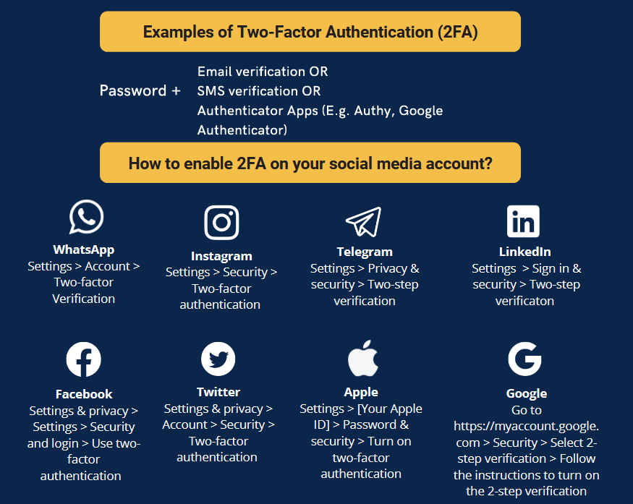
4. Online Safety
Use two-factor authentication (2FA)

Slide 32
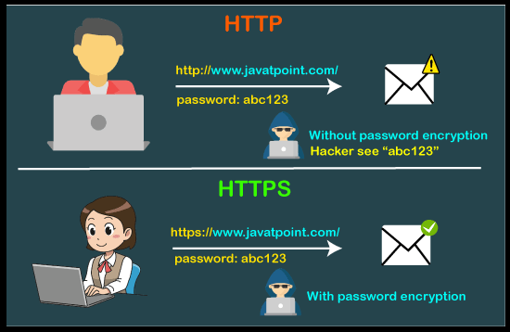
4. Online Safety
HTTP vs HTTPS
No:
Data is not encrypted, making it vulnerable to interception by third parties.
URLs begin with "http://"
Yes:
Data is encrypted, making it more secure from interception by third parties.
URLs begin with "https://"

Slide 33
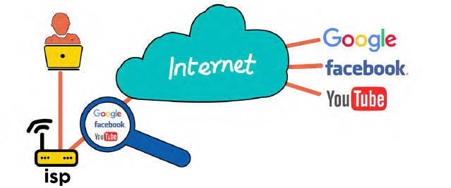
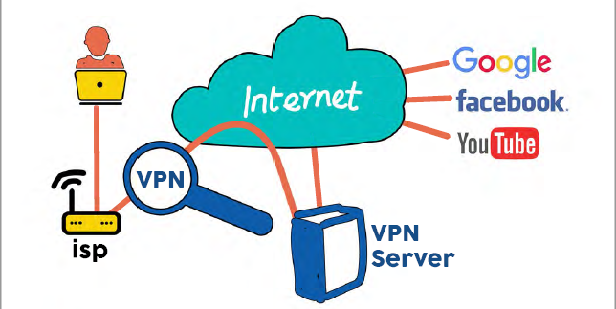
4. Online Safety
Protect your connection to the internet by using a VPN
Without a VPN:
With VPN:

Slide 34
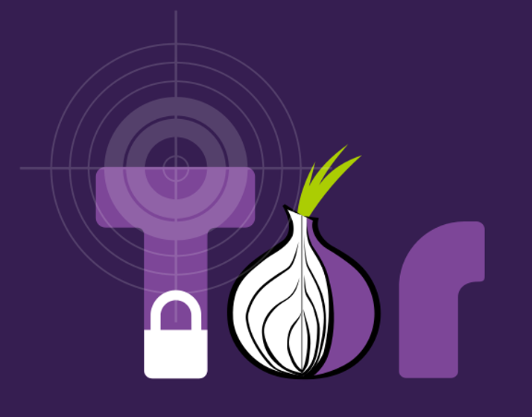
4. Online Safety
Tor Browser
Sends your internet activity through layers of servers.
Your activity bounces around the network until it reaches its destination.
Provides anonymity online, making it difficult for anyone to track your internet activity.
Can be slow at times.
Don’t believe? Try the location test!
Notes:
Hide your activity = VPN
Hide your identify = TOR

Slide 35
4. Online Safety
Google Settings
Go to https://myaccount.google.com/
Checklist to run through:
Third-party apps with account access
2-Step Verification
Location history
Recovery (email and phone)
Recent security activity
Devices (that are signed in to the account)

Slide 36
Phishing: Understanding and Preventing Attacks

Slide 37
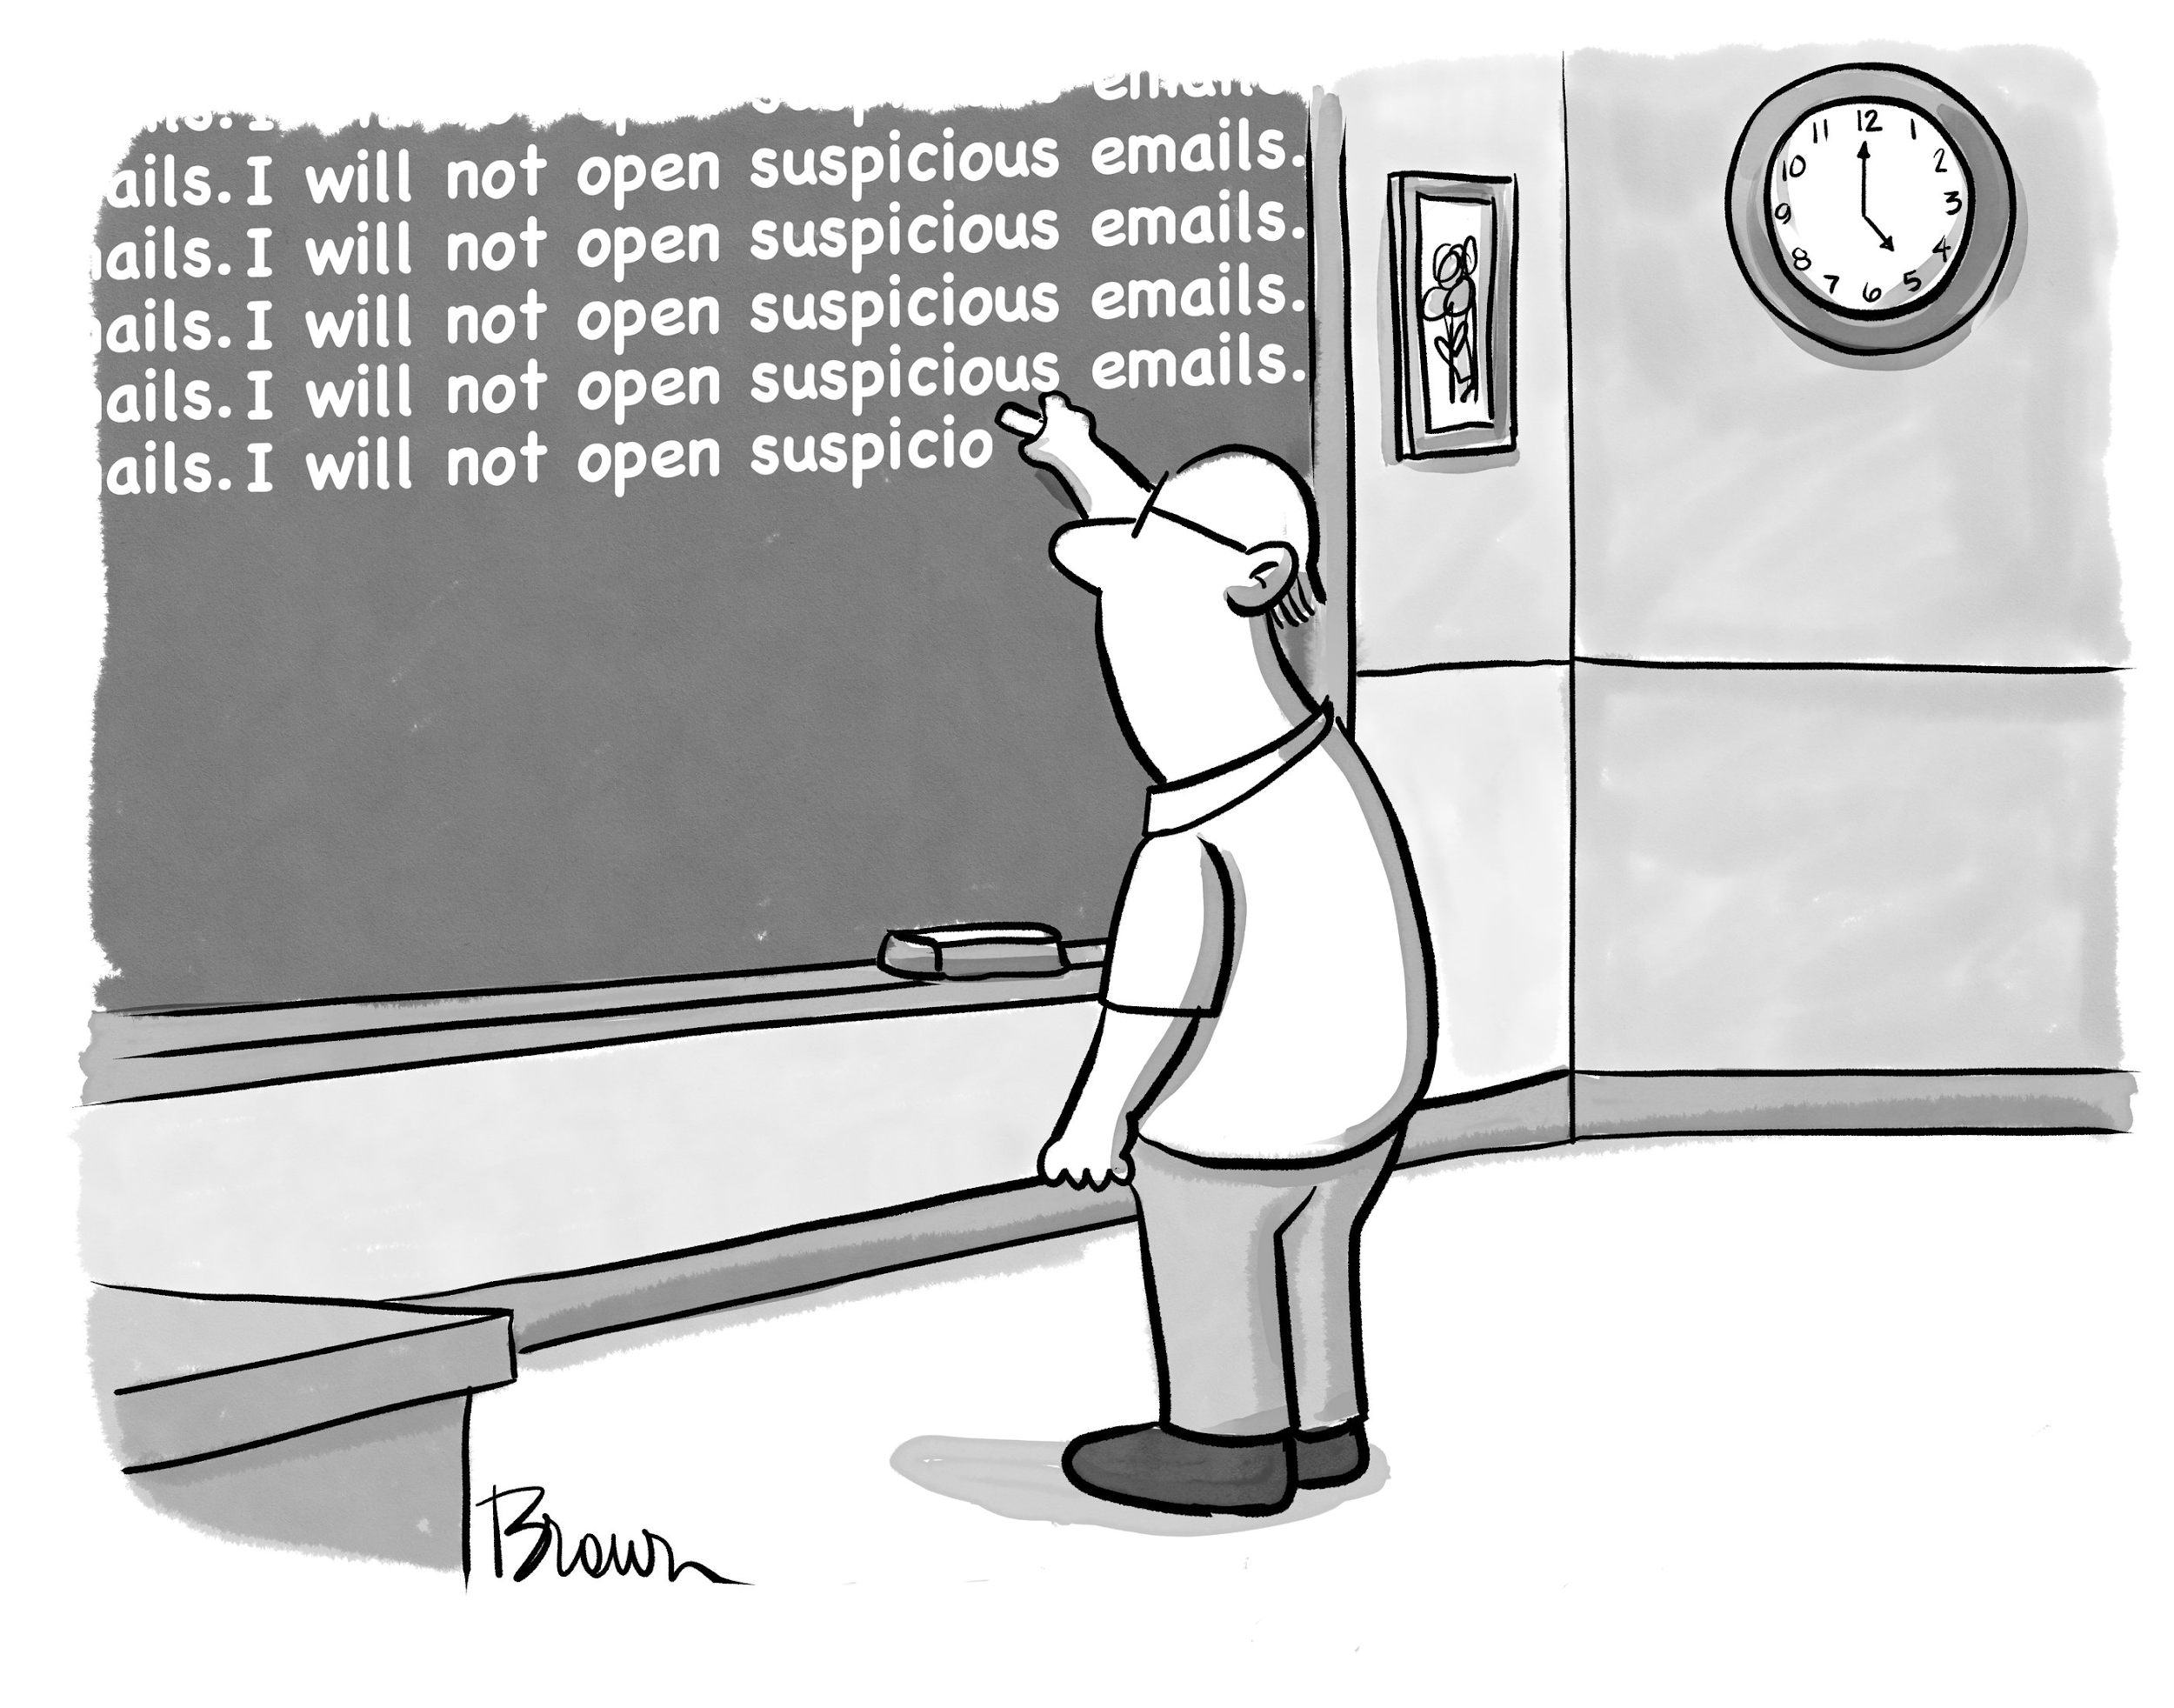
5. Phishing: Understanding and Preventing Attacks
Phishing is a type of online scam where attackers send fake messages or emails or calls that appear to be from a trustworthy source in order to steal sensitive information such as passwords or credit card numbers.

Slide 38
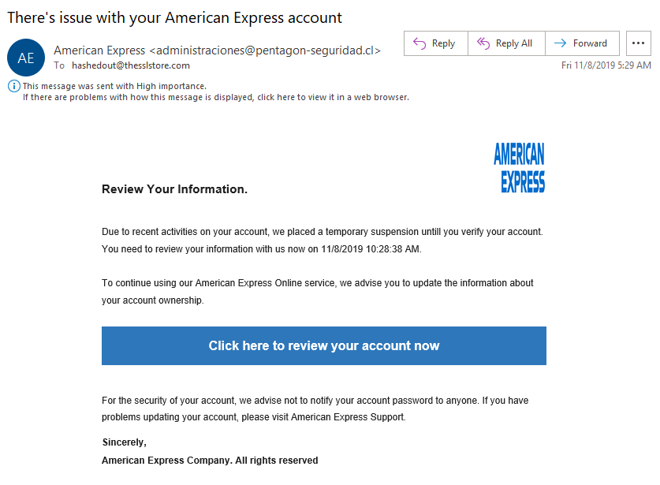
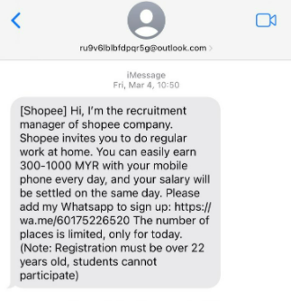
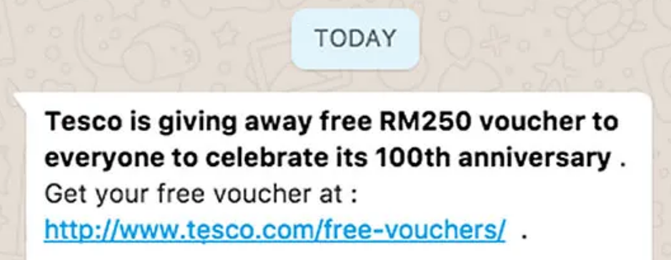
5. Phishing: Understanding and Preventing Attacks
How to identify a phishing email/message?
Demanding urgent action.
Bad grammar and spelling mistakes.
Inconsistencies in email addresses, links, and domain names.
Suspicious attachments (.zip, .exe, etc.).
Emails requesting login credentials, payment information, or sensitive data.
Too good to be true.

Slide 39
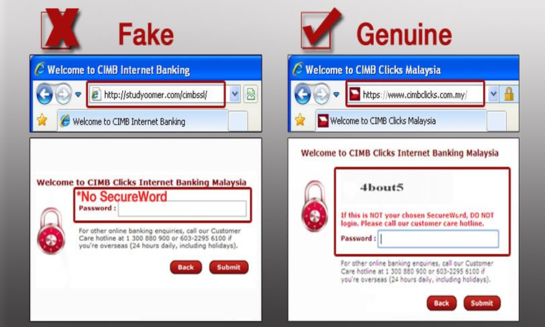
5. Phishing: Understanding and Preventing Attacks
How to avoid phishing traps?
Hover your mouse cursor over the link (without clicking) to see the actual web address.
Verify that the site's address matches exactly with the legitimate site. If it doesn't match, it could be a fake site.
Ensure that the site's address starts with "https" instead of "http". If you have any doubts, immediately close the webpage.
Use your usual method of accessing the website rather than clicking on the link you received.

Slide 40

Quiz 2
https://phishingquiz.withgoogle.com/
Phishing Quiz

Slide 41

6. Phishing: Understanding and Preventing Attacks
Useful tools:
https://www.virustotal.com/gui/home/upload
https://www.browserling.com/
Google Drive and Proton Drive (for sandboxing purposes)
Sandbox

Slide 42
THANK YOU!
Question?
Email us at:
info@securitymatters.asia
Or
Text us on WhatsApp or Signal: +60 16-298 2046
@secm8
@sec_matters

Slide 43
Extras

Slide 44
Quiz 3
https://quiz.shira.app/

